Slide 1
UNIT I INTRODUCTION TO ALGORITM DESIGN

Slide 2
Substitution method
Guess the solution.
Use induction to find the constants and show that the solution works.

Slide 3
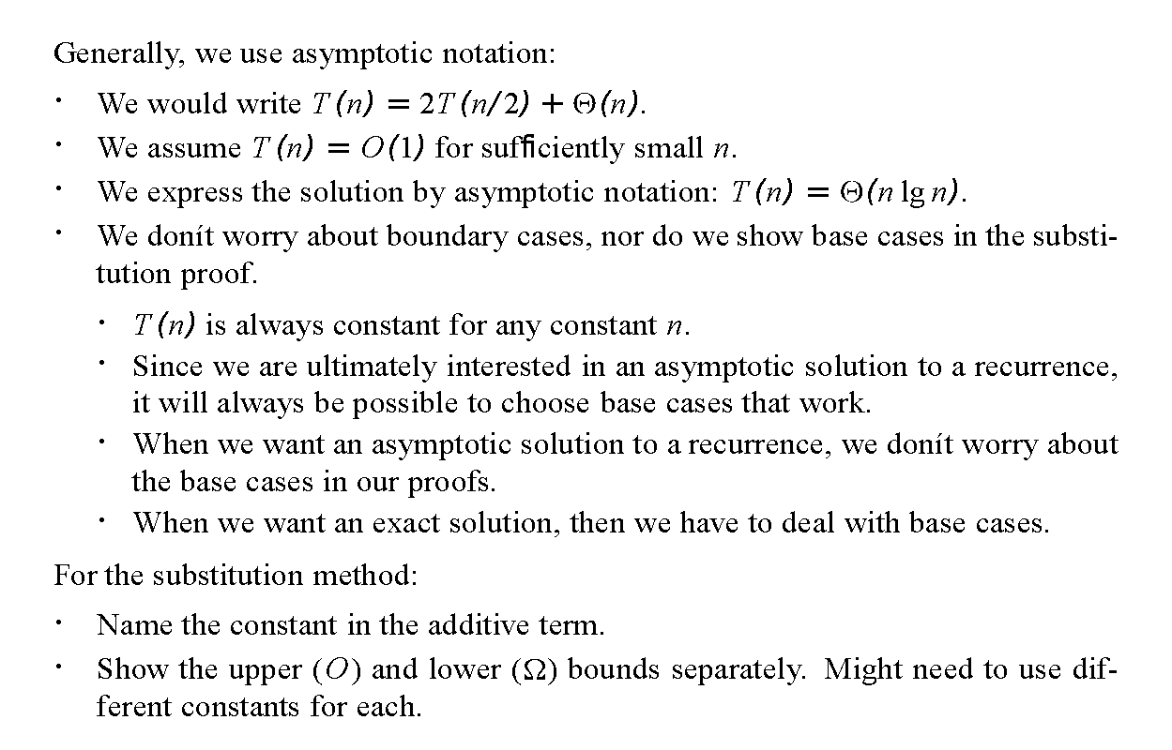

Slide 4
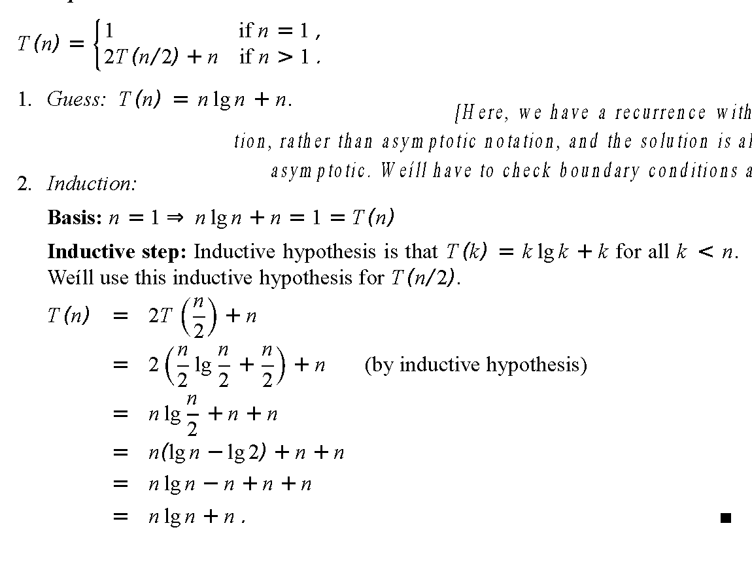
Example

Slide 5
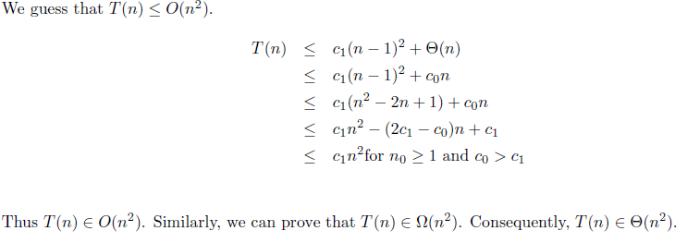
Another Example
How to prove by the substitution method that if T(n)=T(n−1)+Θ(n)then T(n)=Θ(n²)

Slide 6
Video Link
https://www.youtube.com/watch?v=Zhhh9qpAVN0

